Slide 1
Student Insurance Powered by Venbrook Higher Education
Student-Athlete Accident Program 2024-25
Anthem S.A.I.N Claim Filing
Primary vs. Secondary Insurance
Catastrophic- Schedule of Benefits
HIPAA and Claim forms
Samples of Provider Billings and EOBs
S.A.I.N Brochure
Student / S.A.I.N Contacts
Student Insurance Microsite

Slide 2
San Diego CCD S.A.I.N Claim Filing Instructions
Documents Needed to Start a Claim:
Claim Form: Must be submitted by the college with complete details surrounding the injury. The claim form should be submitted as soon as possible.
HIPAA Form: This form must be submitted with every completed claim form so that anyone at the college or Student Insurance can assist with treatment arrangements, bills, appointments, and any other medical information needs.
Once completed, please email Student Insurance for processing. Student Insurance will send to Anthem to assign a claim control number (N#) that providers will use to bill Anthem on behalf of the claimant. Once Student Insurance has obtained the Claim Control number, it will be provided to the person who submitted the claim.
Documents Needed to Pay Claims
Fully Itemized Bill: Typically submitted by health care providers, bills are sometimes sent to the primary policyholder (student-athlete or parent). In this case, send a copy to Student Insurance, and we will handle it.
The bill must contain the diagnosis codes and the amount each treatment charges. These bills are called HCFA-1500 for a doctor’s office or UB-04 for a hospital report.
Balance Due Bill: A statement or receipt that only shows the amount billed will NOT be paid
Explanation of Benefits (EOB): A summary generated by an insurance company explaining how a claim was processed. It will include the insured’s name, date of treatment, the amount charged by the provider, the amounts covered and not covered under the insurance plan, and possibly an amount the student/patient is responsible for.

Slide 3
Primary vs. Secondary Insurance
Primary Insurance
A primary policy is coverage that a parent may have through their place of employment, a policy purchased on the Affordable Care Act exchange, or, in some cases, a medical health insurance plan provided by the school. These are all considered “primary.” This means injuries at the college, at a supervised college event, or during a sports activity will first be handled through that primary insurance.
However, certain types of insurance have limitations, especially regarding intercollegiate sports injuries. This is why you must provide all insurance information regardless of what it may or may not cover.
NOT Primary Insurance
Government-Sponsored Insurance (TriCare, Medicaid, etc.): These plans do not pay as primary insurance when the school has accident Insurance.
Student Health Insurance Plan (SHIP): SHIPs may specifically state that injuries related to intercollegiate athletics are not covered. All other injuries may be paid as primary.
“Religious Ministry” Plans: Ministry plans often exclude intercollegiate athletics or rely on a discretionary claim process; coverage may not meet the institution's primary insurance requirements.
School-Sponsored Accident Coverage
In the cases of no primary insurance, the student/athlete accident insurance policy will pay as
primary for accident-related injuries within the limits of coverage under the school’s policy. The institution's accident policy is for all students, including intercollegiate sports.
This is an “accident-only” plan, meaning illnesses are not covered.
The Anthem policy provides payment of 100% of allowed charges incurred within 365 days following the date of injury. Treatment by a licensed medical doctor must be sought within 90 days of the accident.
Injuries must be reported to the appropriate staff or faculty for documentation of a claim before
treatment.

Slide 4
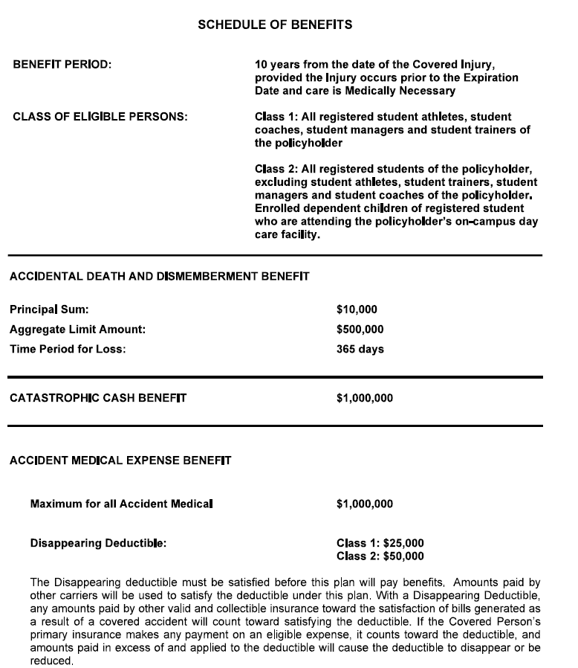
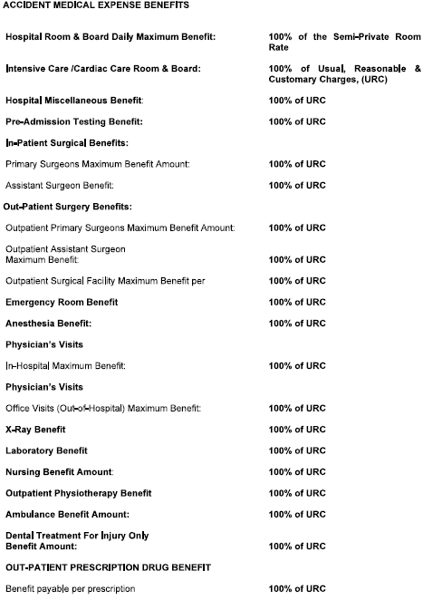
San Diego CCD- Catastrophic Coverage (Crum and Forster)

Slide 5
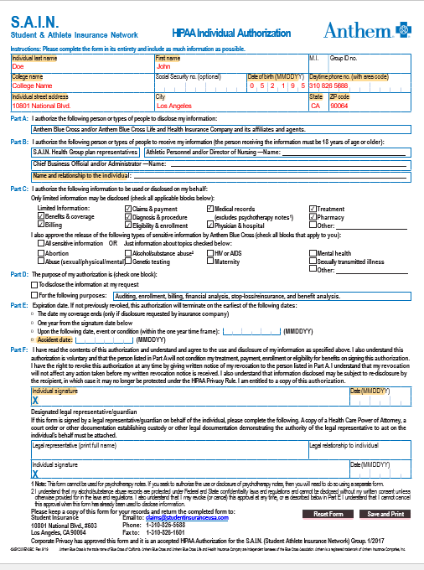
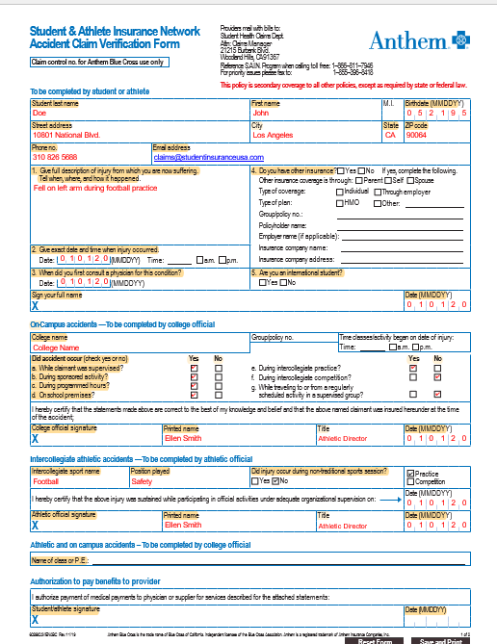
Anthem S.A.I.N (Student-Athlete Insurance Network HIPAA Form and Claim Form
HC ID# (Claim ID) N# (8-Digits) - 00000000

Slide 6
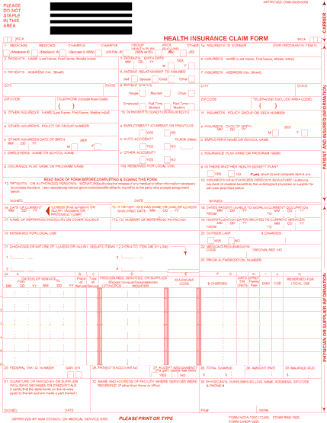
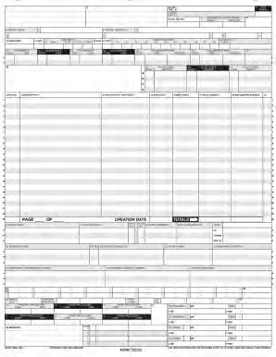
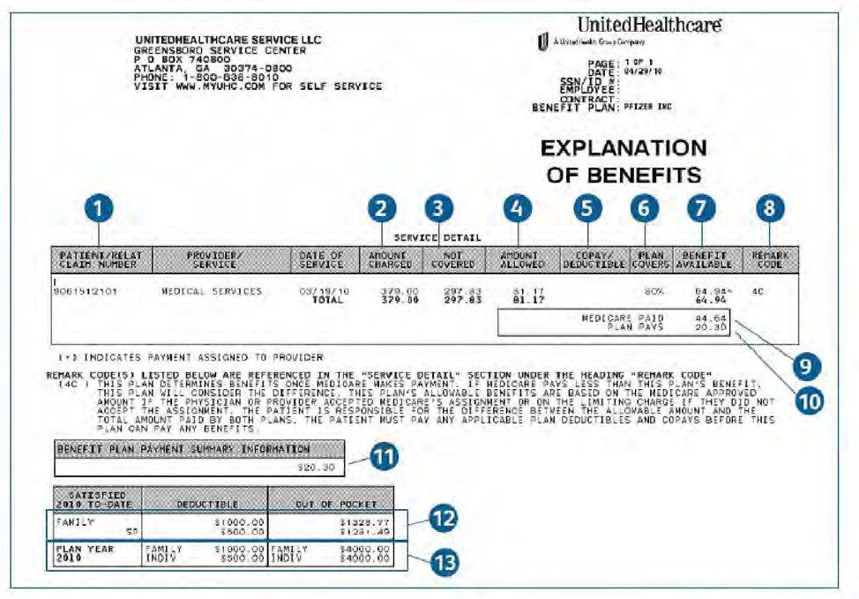
Sample Provider Billing
SAMPLE HCFA 1500
SAMPLE UB-04
SAMPLE EOB (EXPLANATION OF BENEFITS)

Slide 7
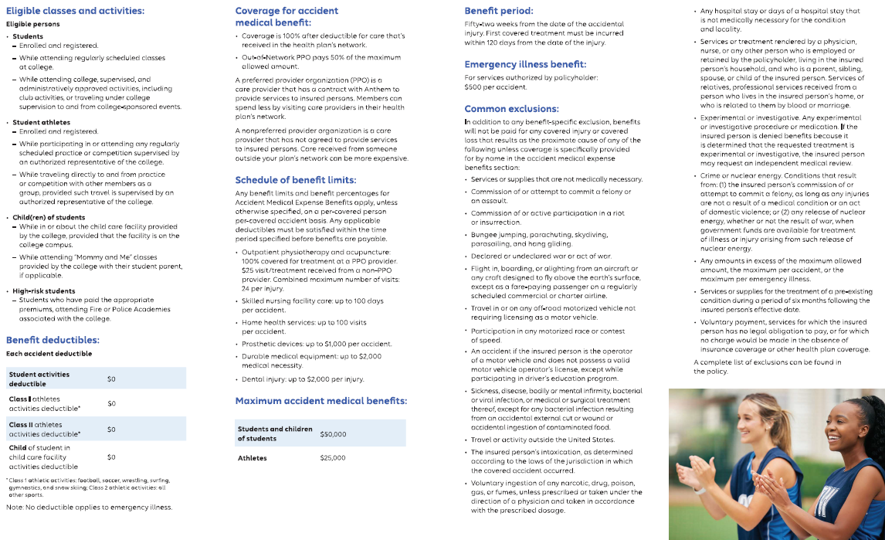
San Diego CCD- S.A.I.N Flyer

Slide 8
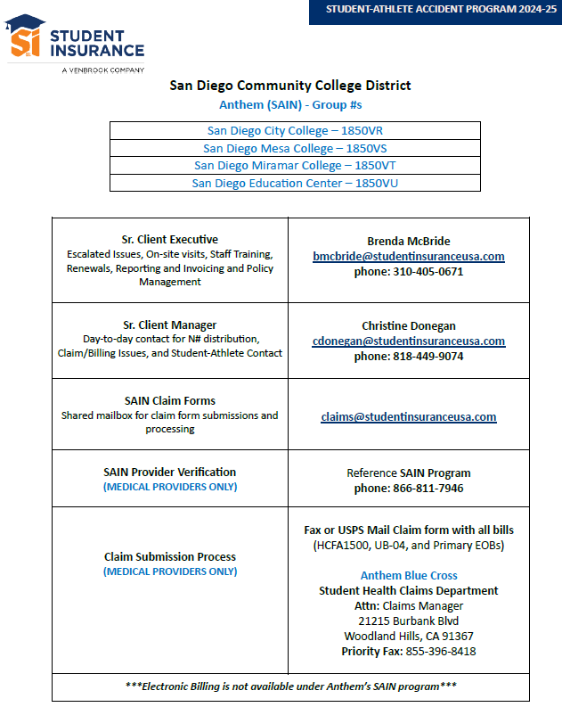
Student Insurance and S.A.I.N Program Contacts

Slide 9
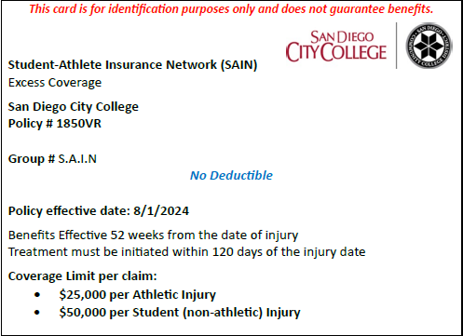
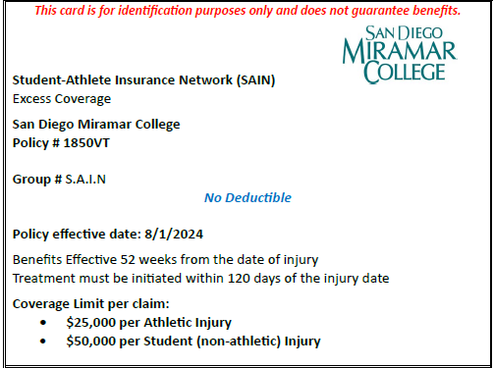
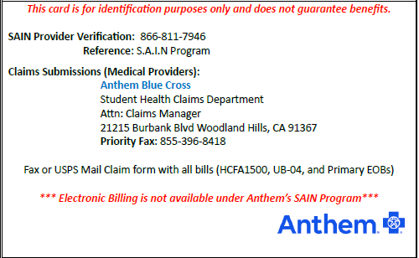
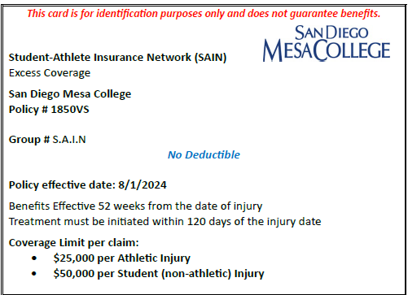
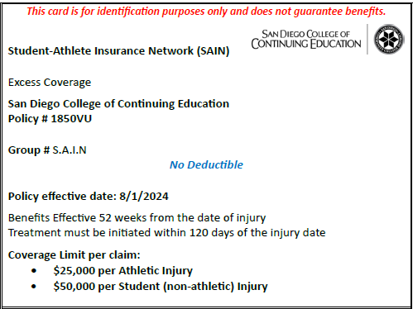
Anthem ID – Information ID cards

Slide 10
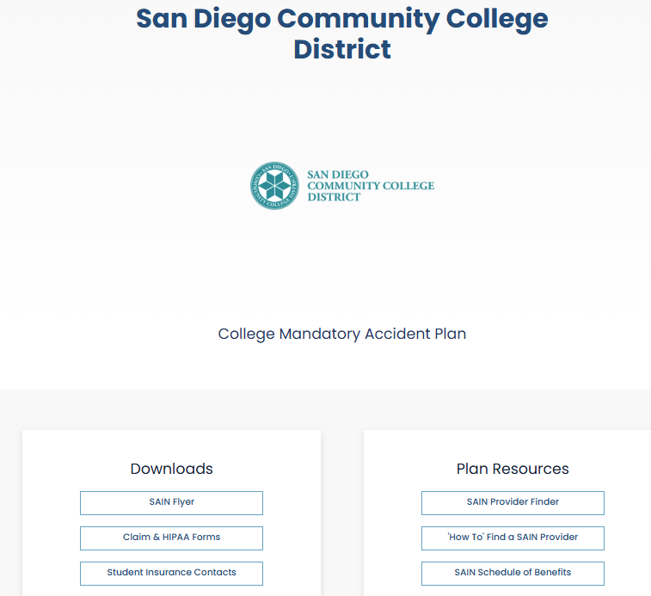
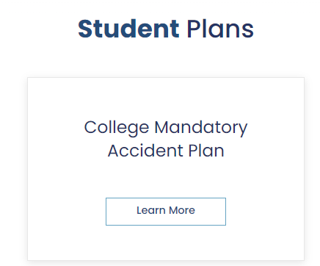
Student Insurance Microsite:
College Mandatory Accident Plan - Student Insurance

